Slide 1




SMART INDIA HACKATHON 2025
Problem Statement ID –25050
Problem Statement Title- Smart Traffic
Management for Urban Congestion
Theme- Transportation & Logistics
PS Category- Software
Team ID- GID_331
Team Name- Rush Hour Ninjas

Slide 2
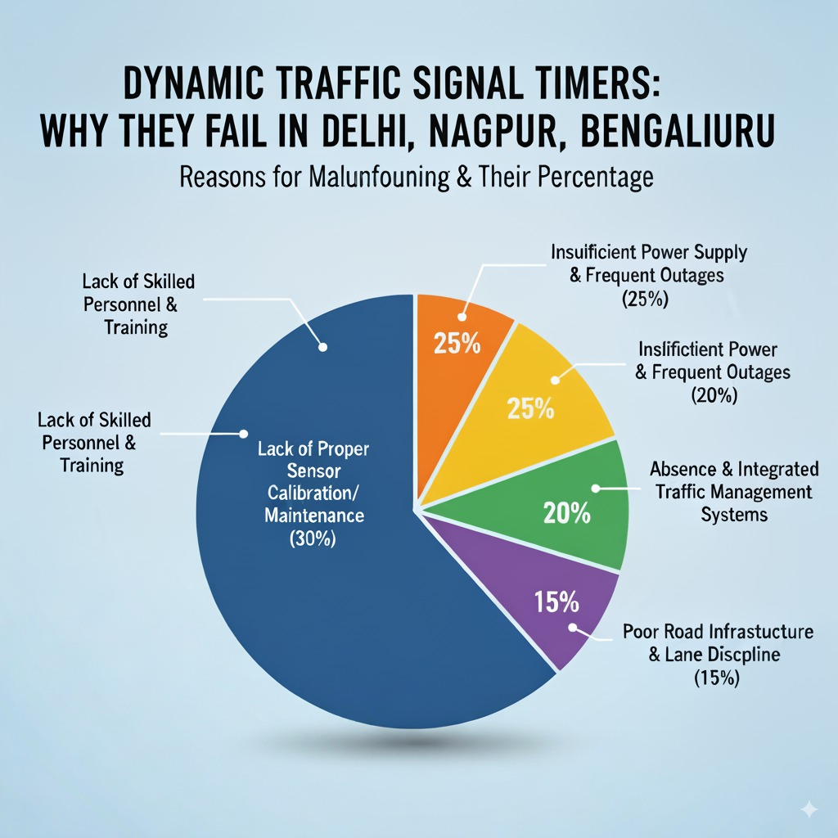
Rush
Hour
Ninjas
GAPS IN EXISTING SYSTEM
Camera Detection Failure
The cameras are often unable to detect motion properly. Recorded videos freeze ,which affects real time monitoring
Power Supply Issues
Frequent power cuts lead to complete shutdown of traffic signals. In case of long outages, the entire system remains non-functional
Delayed Repairs
Even when faulty timers are reported , they are not repaired on the time. This reduces reliability of the traffic management system.
Non –Functional Count Timers
Around 40% of the timers are not working. Many of these cases go unreported leading to pro-longed issues
.
Signal Transmission Error
Frequent power cuts lead to complete shutdown of traffic signals. In case of long outages, the entire system remains non-functional
Undertrained Algorithm
The AI/algorithm used for traffic detection and control is not well-trained.It struggles with accuracy ,leading to inefficient signal management.

Slide 3
Fail Safe Feature
Rush
Hour
Ninjas
Voltage Check
Checks Voltage by checking the input Voltage
Camera check
Reports if the camera froze in between or gives black screen
solutions
Network check
Verifies whether the traffic signal is working or not by sending a signal after every 50 sec and if the signal is not received after 120 sec it sends the update to the dashboard that the traffic signal is not working
Frame Check
Checks the alternate frames and reports it the frames are not in the right order
Heartbeat

Slide 4

Rush
Hour
Ninjas
Watchdog
Purpose
Prevents the traffic signals from getting stuck in one state .
Ensures continuous operation even during software or hardware glitches
How it works
Controller must "reset" the watchdog timer periodically.
Benefits
Increases system reliability and fault tolerance.
Reduces manual intervention by auto-recovering from crashes
Ensures uninterrupted traffic flow and safety
If it fails ->Watchdog auto-resets the system.
A self - monitoring timer inside each traffic controller that resets the system if it hangs or malfunctions

Slide 5
Rush
Hour
Ninjas
Model Training & Data collection
Data Collection Sources:
AI City Challenge
Roboflow
Kaggle
Category classification:
Car
Truck
Pedestrian
Bicycles
Annotation Tools:
Roboflow
LabelImg
Preprocessing:
Frame resizing
Bounding box normalization
Augmentation Techniques:
Horizontal flips
Blur effects
Brightness variations
Performance Results & Real-World Impact
85%
mAP@50 Accuracy
Exceptional detection precision across all five vehicle and pedestrian classes
35
Frames Per Second
Real-time inference speed enabling dynamic traffic signal optimization
Bike
Bus
Auto
Accidents
Key Outcomes:-
Real-time detection of vehicles and pedestrians with high accuracy.
Precise vehicle counting enables dynamic signal timing adjustments.
Robust performance across varying lighting conditions and weather scenarios
Architecture: YOLOv8
Data Split: 70% Train | 20% Validation | 10% Test
Training: 100+ epochs, batch size = 16
Optimizer: Adam
Hardware: NVIDIA RTX-3050 (6GB)
Loss Functions: CIoU + BCE

Slide 6
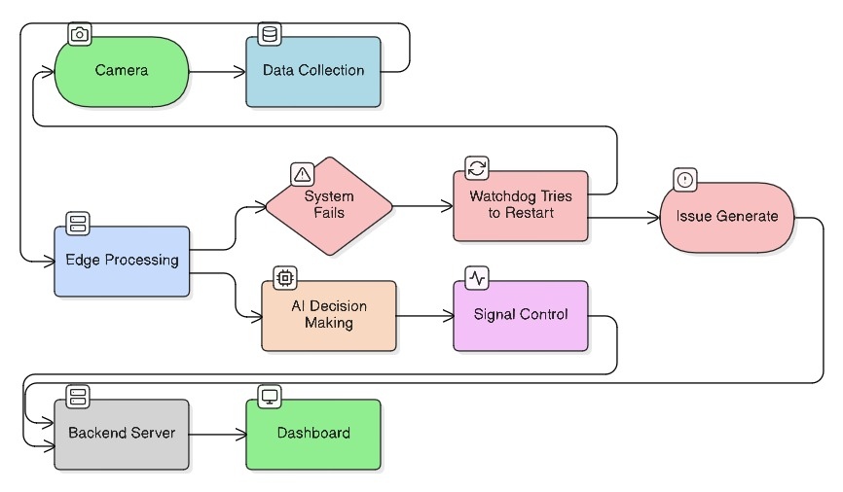
TECHNICAL APPROACH AND WORKFLOW
Rush
Hour
Ninjas

Slide 7
SmartFlow vs. Existing: A Clear Advantage
Rush
Hour
Ninjas
Our system doesn't just improve traffic flow; it redefines reliability and responsiveness, setting a new standard for urban transportation infrastructure and public safety.
CRITERIA | Existing | SmartFlow
Multi-class Vehicle Detection | ❌ Basic counting only | ✅ Advanced AI classification
Lane-level Optimization | ❌ Limited | ✅ Precise, real-time adjustments
Accident/Obstruction Alerts | ❌ None | ✅ Immediate, granular notifications
Weather-aware Timing | ❌ Unresponsive | ✅ Adaptive to environmental conditions
Fail-safe Flash/Fixed Mode | ❌ Partial/Manual | ✅ Automated & resilient
Authority Notifications | ❌ None | ✅ Instant multi-channel alerts
Citizen Transparency | ❌ Minimal | ✅ Potential for public communication

Slide 8

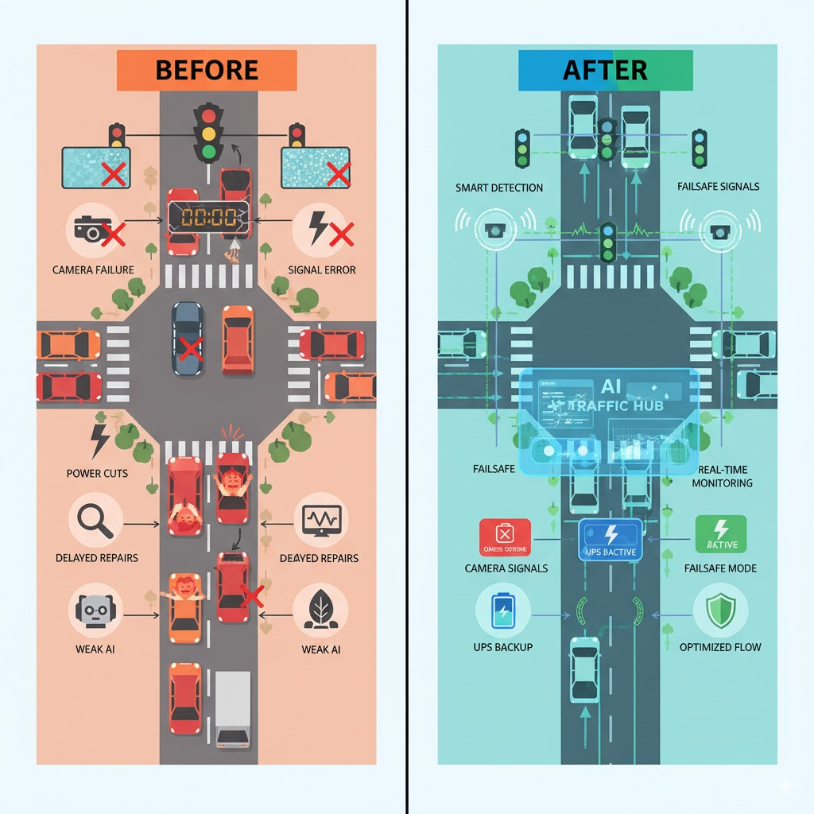




IMPACT AND BENEFITS
Rush
Hour
Ninjas
Technological Impact
Adaptive signals reduce waiting time compared to fixed timers.
Historical traffic data stored in database can be used by city planners for designing better road networks.
Government / Policy impact
Queue length + camera sensors can also detect red light violations, wrong-side driving, overspeeding.
This helps government automate e-challans and reduce manual policing.
Economic Savings
Adaptive signals reduce idle time → less petrol/diesel burned.
Example: If each car saves just 0.1 litre/day, across 1 lakh vehicles.
It's approx 10,000 litres saved daily.
Environmental Impacts
Lowers emissions and fuel use. Promotes energy efficiency
and supports sustainable urban planning.
Social Benefits
Reduced Stress & Road Rage.
Less waiting and smoother traffic =.Calmer driving experience.
Fewer fights, honking, and rash driving at congested junctions.

Slide 9
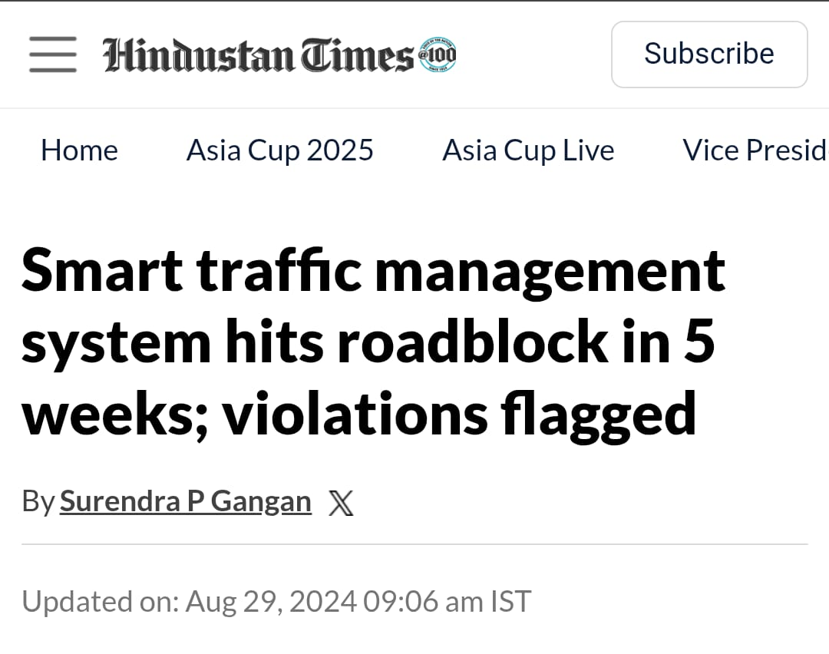
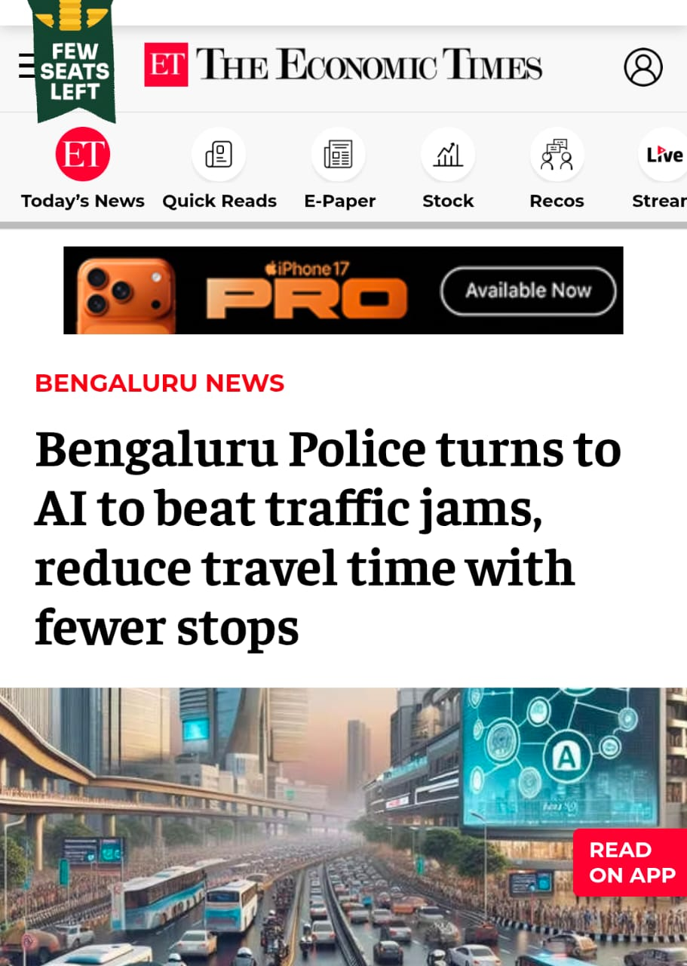
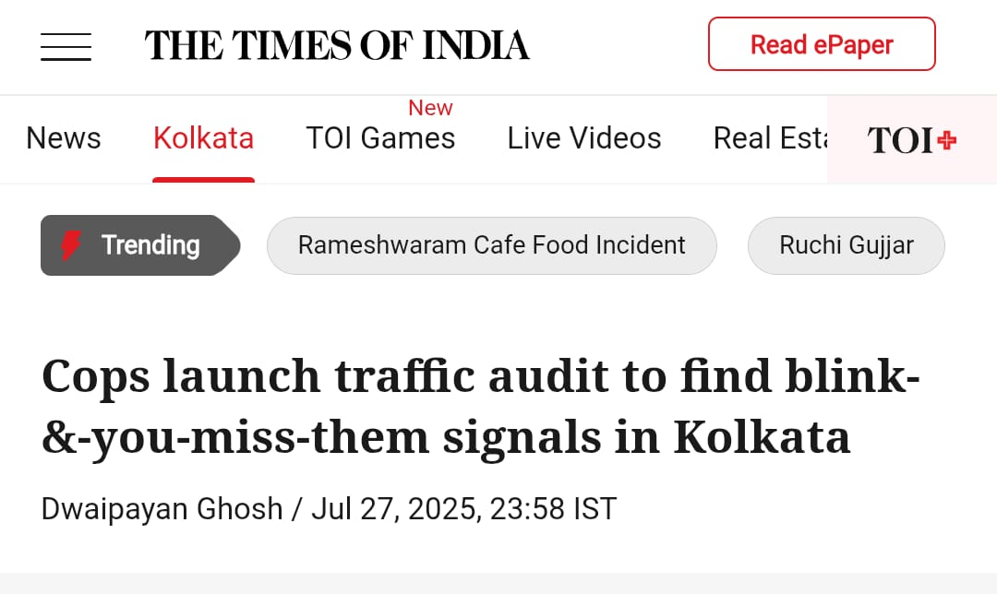
RESEARCH AND REFERENCES
Rush
Hour
Ninjas
Sources:
Mumbai
https://share.google/z5RrifWcLHbQvgZUw
Mangaluru
https://timesofindia.indiatimes.com/city/mangaluru/smart-traffic-signals-trial-faces-delays-and-disruptions/articleshow/121144977.cms
Kolkata
https://share.google/ZQgy0Tebrg8eap4UB

